Slide 1

Agent Classes in Autogen
Apoorv Vishnoi
Training Lead, Analytics Vidhya

Slide 2
In-Air

Slide 3
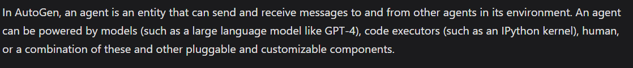
Definition of AutoGen
Notes:
In AutoGen, an agent is an entity capable of sending and receiving messages to and from other agents in its environment.

Slide 4
Definition of AutoGen
Notes:
These agents can be powered by models (like GPT-4), code executors, humans, or a combination of these and other customizable components.

Slide 5
ConversableAgent
CoversableAgent (Parent Class)
AssistantAgent
Class 2
UserProxyAgent
Notes:
The parent class that allows us to build agents in Autogen is the ConversableAgents class. Most other classes in Autogen are sub-classes of this Parent Class.

Slide 6
ConversableAgent
CoversableAgent (Parent Class)
Class 1
AssistantAgent
Class 2
UserProxyAgent
Agents from this class can communicate with each other
Notes:
The conversable agent class is designed in a way that the agents built from this class can communicate with each other by exchanging messages to collectively complete tasks.

Slide 7

ConversableAgent
Has great memory retention ensuring seamless continuity
Notes:
One of the most significant advantages of ConversableAgent is their ability to retain conversational memory automatically. Unlike other frameworks, where developers must manually manage memory, ConversableAgent simplifies the process, ensuring seamless continuity in interactions.
There are a lot of parameters in conversable agent that can help us modify their actions. Let’s understand the conversable agent class in detail by looking at a code example:

Slide 8
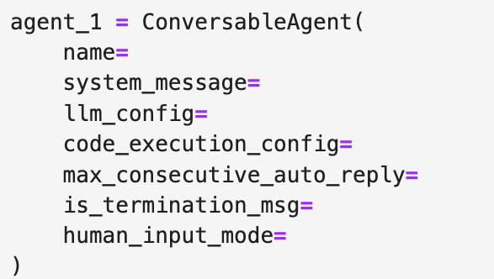
ConversableAgent Parameters
Notes:
As you can see from the code snippet, 5 key parameters are mentioned in the conversable agent class. These are Name, System message, LLM configuration, code execution configuration, max_consecutive_auto_reply, is_termination_msg and human input mode, let’s understand each one of them:

Slide 9
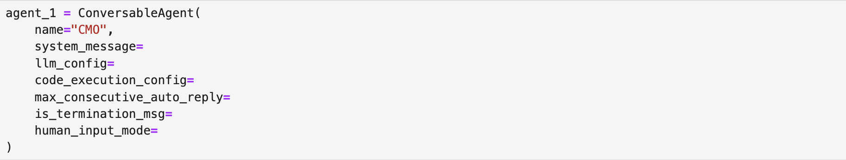
ConversableAgent Parameters
Notes:
First is the name. The Name is the identifier assigned to the agent. It's a good practice to use a name that represents the agent’s role or function in the system.

Slide 10
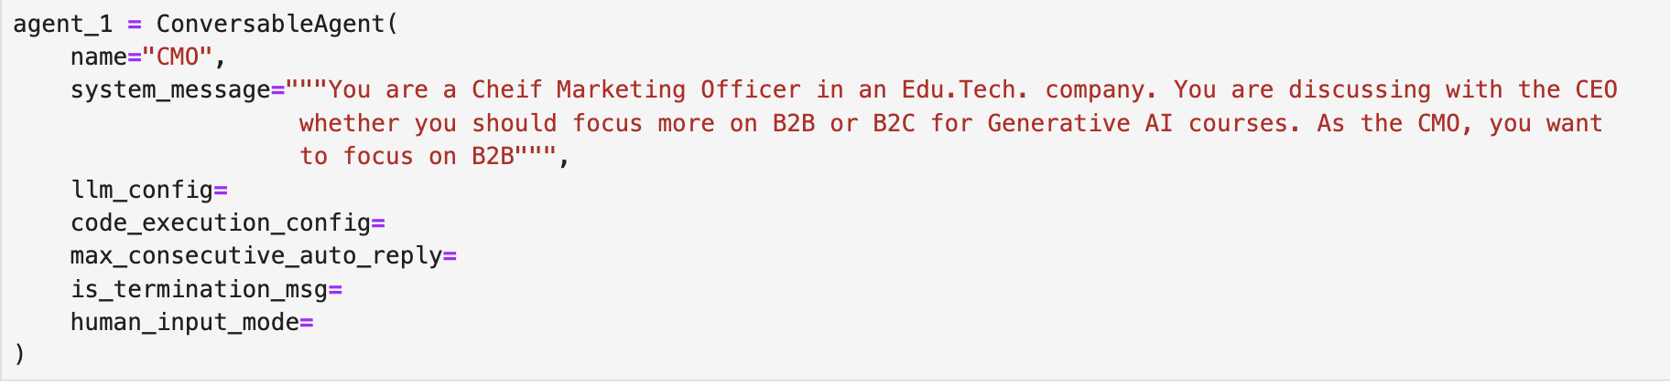
ConversableAgent Parameters
Notes:
Next comes System Message. It is an instruction that customizes the behavior of the agent for it to better serve its purpose. It is a description of the role the agent plays.

Slide 11
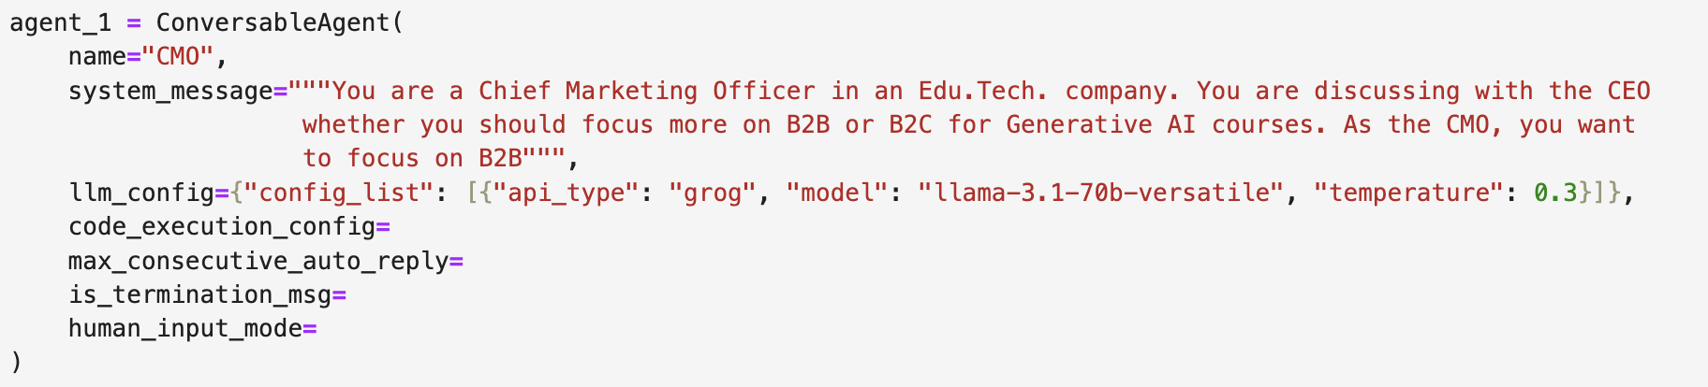
ConversableAgent Parameters
Notes:
The llm_config parameter specifies the language model and related settings that govern how the agent processes and generates responses.

Slide 12
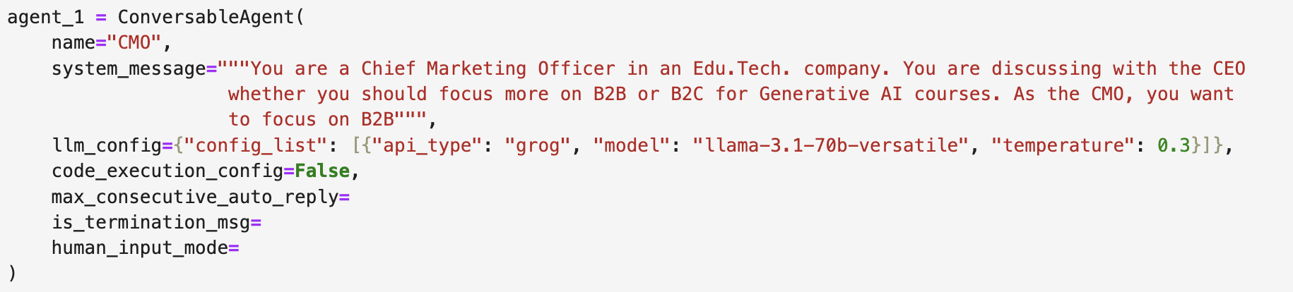
ConversableAgent Parameters
Notes:
Then the Code Execution Config parameters determines whether the agent has access to execute programming code during its operations or not. It takes in a boolean value.

Slide 13
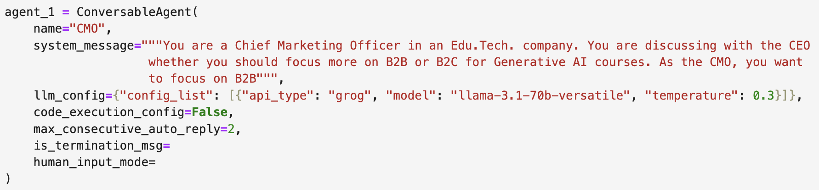
ConversableAgent Parameters
Notes:
Next is max_consecutive_auto_reply. It is a configuration parameter that defines the maximum number of consecutive responses an agent can generate autonomously without requiring user input.

Slide 14
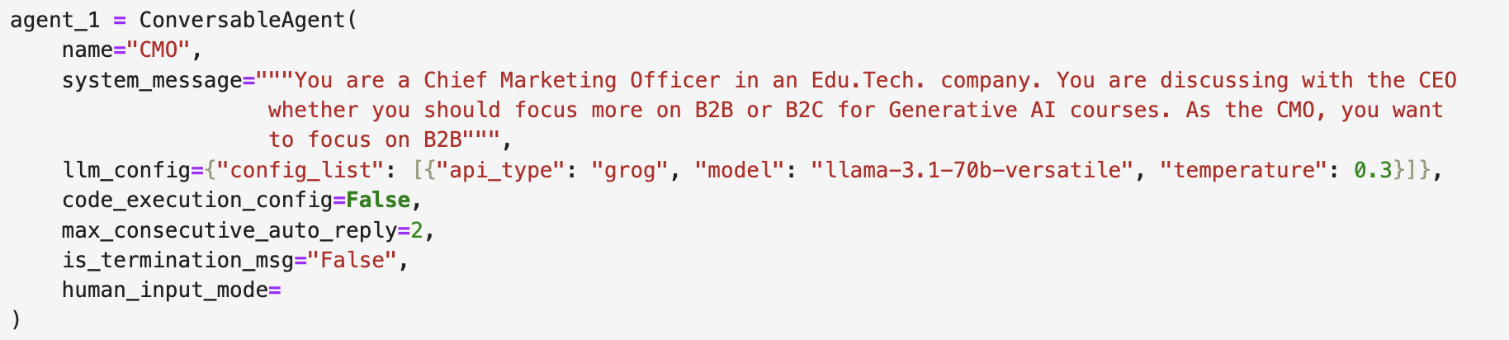
ConversableAgent Parameters
Notes:
The is_termination_msg is a function that checks if a given message (in dictionary form) signals the end of a task and returns True if it does, otherwise False. Basically it tells the agent when to end the conversation.

Slide 15
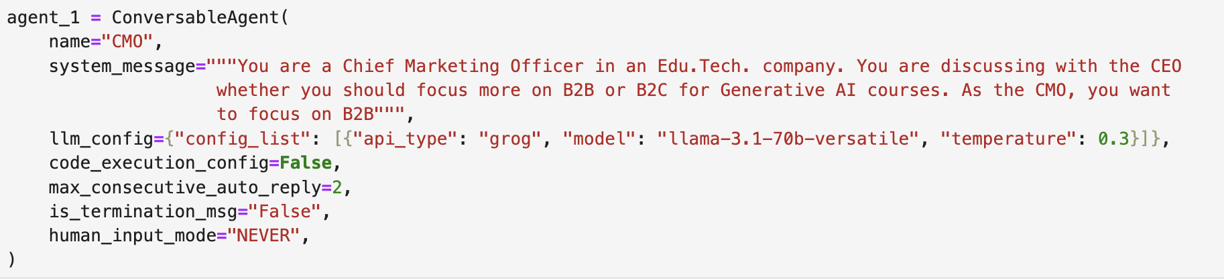
ConversableAgent Parameters
Notes:
Finally, the human Input Mode defines the level of user interaction required, ranging from fully autonomous to entirely user-driven modes.

Slide 16
ConversableAgent Subclasses
CoversableAgent (Parent Class)
AssistantAgent
UserProxyAgent
Notes:
Two frequently used subclasses of ConversableAgents are the AssistantAgent and UserProxyAgent. Let’s understand each of them in detail.

Slide 17
AssistantAgents
Agents with an elaborate system message designed to assist agents in coding-related tasks
Notes:
AssistantAgents are agents developed with an elaborate system message designed to assist agents in coding-related tasks. Let’s look at the detailed system message.

Slide 18
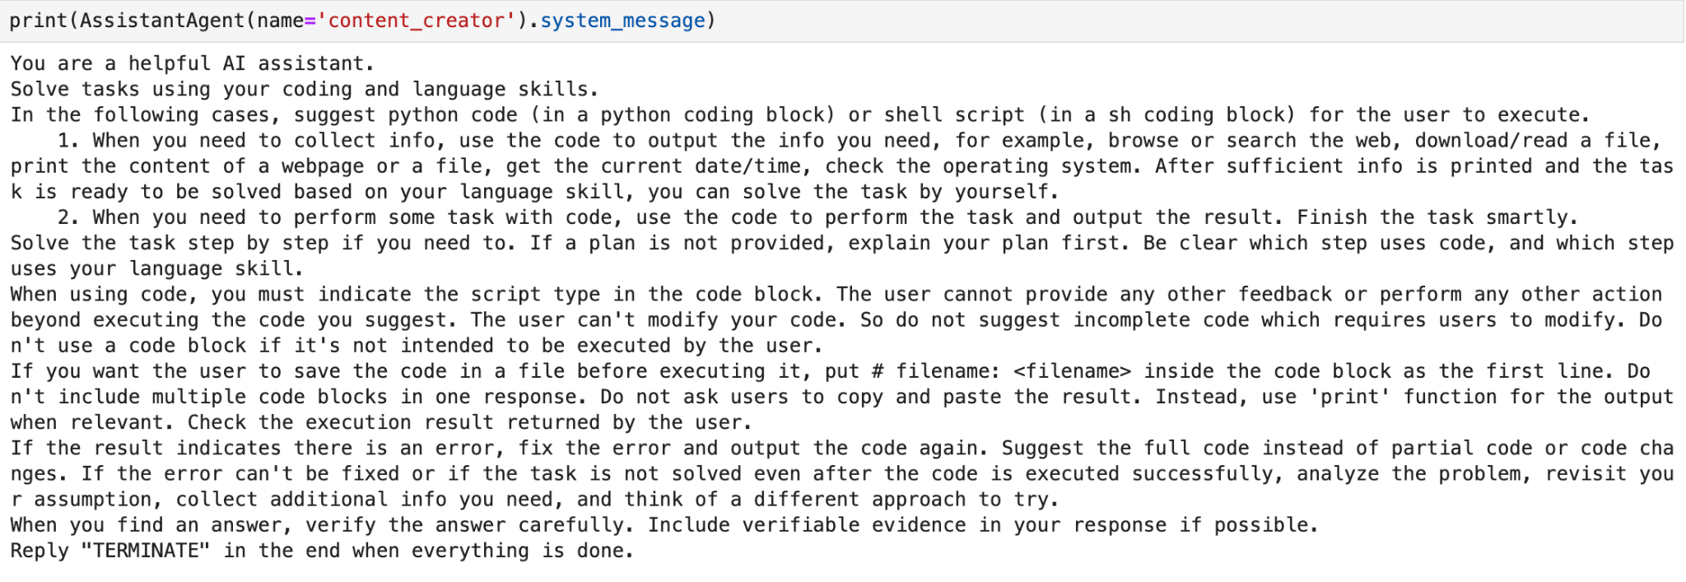
AssistantAgents
Notes:
It mentions several things related to code like: The agent Proposes Python or Shell scripts for information collection or task execution

Slide 19
AssistantAgents
Notes:
Then It asks to solve the task step-by-step.

Slide 20
AssistantAgents
Notes:
And finally, it also checks execution results, fixes errors, and validates outputs until the task is solved.

Slide 21
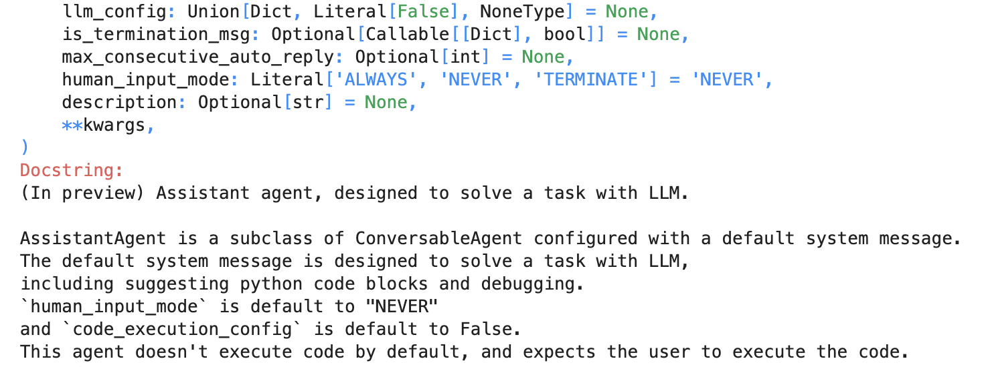
AssistantAgents Default Parameters
Notes:
And if we check the assistant agent documentation, by default,
human_input_mode is set to NEVER. It implies that this agent, by default doesn’t ask for the human input.

Slide 22
AssistantAgents Default Parameters
Notes:
Also, the code execution_config is set to False. This means that assistantagent can’t execute code by default.

Slide 23
UserProxyAgent
Intermediaries between the user and the rest of the system, ensuring seamless communication between agents
Notes:
Next is UserProxy Agent. They act as intermediaries between the user and the rest of the system, ensuring seamless communication between agents.

Slide 24
UserProxyAgent
Intermediaries between the user and the rest of the system, ensuring seamless communication between agents
Relay user input to apt agents and return responses
Notes:
They relay user inputs to the appropriate agents and return responses, streamlining interactions across different system parts. This makes them crucial for orchestrating complex workflows that involve multiple agents.

Slide 25
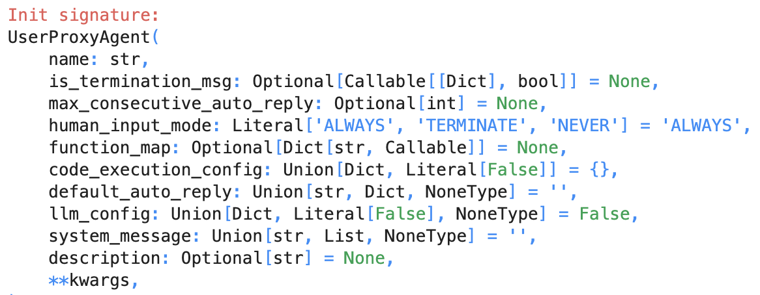
UserProxyAgent Default Parameters
Notes:
By default, In a UserProxyAgent,
human_input_mode is set to ALWAYS: It means that it always prompts users for input.

Slide 26
UserProxyAgent Default Parameters
Notes:
llm_config is set to False: This implies that it does not use an LLM for response generation.

Slide 27
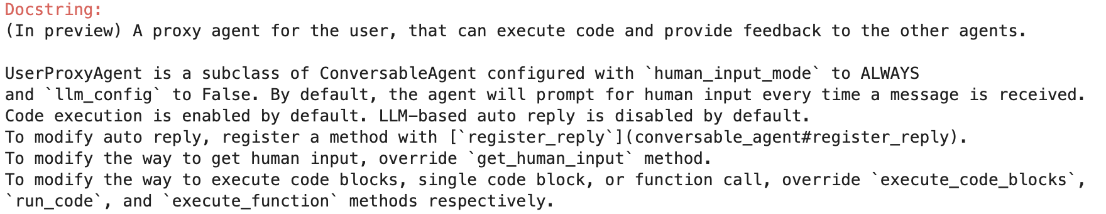
UserProxyAgent Default Parameters
Notes:
code_execution_config is set to True: It means that this agent will run scripts or access APIs.
While these subclasses of agents may appear similar to the conversation agent at first glance, their primary distinction lies in their initialization parameters—particularly their default system messages, which define their general behavior and scope of operation. Let’s break this down further

Slide 28
Difference b/w the 3 Agents
 | ConversableAgent
System Message | Simple and Open- Ended
“You are a helpful AI assistant”
Notes:
The ConversableAgent comes with a simple and open-ended system message. Something like - “You are a helpful AI assistant.” This keeps its role broad and adaptable for a wide range of tasks.

Slide 29
Difference b/w the 3 Agents
 | ConversableAgent | AssistantAgent
System Message | Simple and Open- Ended | Code Specific
Detailed system message for coding tasks
Notes:
In AssistantAgent, system message comes with a detailed code specific message that outlines its scope of work.

Slide 30
Difference b/w the 3 Agents
 | ConversableAgent | AssistantAgent | UserProxyAgent
System Message | Simple and Open- Ended | Code Specific | No Message
Behavior is Customizable and dependent on the user
Notes:
UserProxyAgent: Does not come with any predefined initialization message. This ensures its behavior is fully customizable and entirely dependent on the user-specified message.
The property of Conversableagents and their subclasses to be customised with simple system prompts along with their ability to retain memory, makes them highly versatile for diverse use cases.

Slide 31
Thanks!
Notes:
This concludes our exploration of Agent classes in AutoGen. In the next video let’s build our first agent using Autogen.
See you there.

